Slide 1
Technical Paper Writing
How to Write an Impactful Journal Paper
Matthew Cleary
The University of Sydney
School of Aerospace, Mechanical and Mechatronic Engineering
March 2017

Slide 2
Outline
Selecting a journal
Title of the paper
Structure of the paper
Figures
Writing style
Internal and external peer review

Slide 3
1. Selecting a Journal
Golden Rule - quality rather than quantity.
How do we know the quality of a journal?
What others tell us.
Prestige.
Indices and rankings.
Journal metrics: https://en.wikipedia.org/wiki/Journal_ranking#Measures
Let’s look at impact factor (IF), Eigenfactor score, SCImago Journal Rank (SJR), Journal cited half-life, Journal Citation Reports (JCR), ARWU.

Slide 4
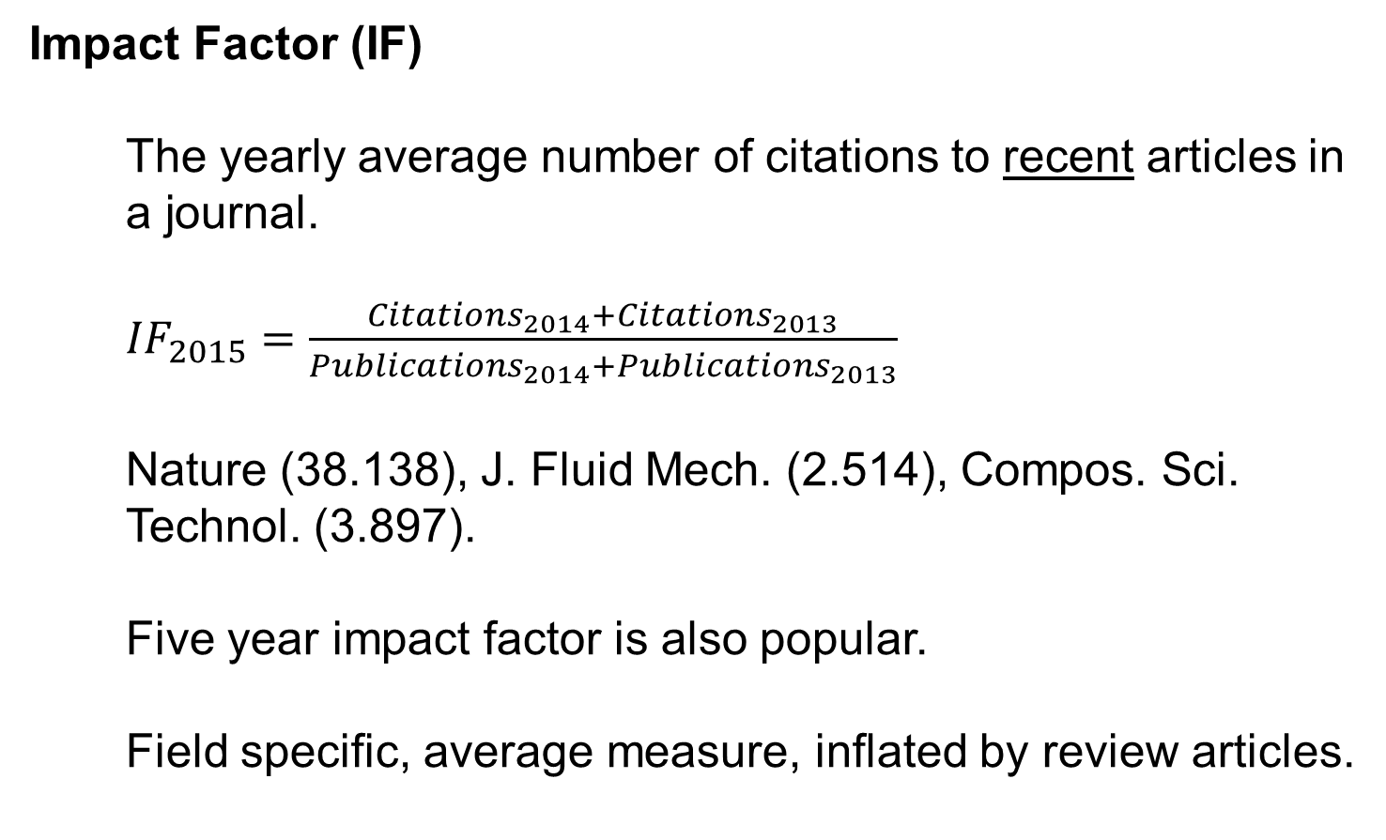
1. Selecting a Journal
Impact Factor (IF)
The yearly average number of citations to recent articles in a journal.
${IF}_{2015}=\frac{{Citations}_{2014}+{Citations}_{2013}}{{Publications}_{2014}+{Publications}_{2013}}$
Nature (38.138), J. Fluid Mech. (2.514), Compos. Sci. Technol. (3.897).
Five year impact factor is also popular.
Field specific, average measure, inflated by review articles.

Slide 5
1. Selecting a Journal
Eigenfactor Score
Similar to IF, but incoming citations are weighted according to the quality of the citing journal.
Nature (1.44256), J. Fluid Mech. (0.05256), Compos. Sci. Technol. (0.02303).
SCImago Journal Rank (SJR)
An extension of the Eigenfactor score. Iterative procedure where prestige of journals is determined until a steady-state is reached.
Nature (21.936), J. Fluid Mech. (1.45), Compos. Sci. Technol. (1.512).

Slide 6
1. Selecting a Journal
Journal Cited Half-Life
The median age of the articles that were cited in the year.
Half the journal’s cited articles were published more recently than the cited half-life.
Nature (> 10 years), J. Fluid Mech. (> 10 years), Compos. Sci. Technol. (8.3 years).
Lower or higher value does not, in itself, indicate quality but it gives you an indication of its purpose (e.g. rapid communication of new ideas versus deep research)

Slide 7
1. Selecting a Journal
How do we get all this data?
Journal Citation Reports
Most of the metrics mentioned above (plus a number of others) are available on the Journal Citation Reports. A yearly report.
Available by through the library (institutional subscription).
Academic Ranking of World Universities (ARWU)
Previously Shanghai Ranking. Established 2003.
Rankings in each field (e.g. ENG or SCI) based on number of journal papers in the ISI Top 20%. Google search USyd journal finder.

Slide 8
2. Title of the Paper
How do you search the literature? (Consider whether you have different strategies for familiar and unfamiliar topics.)
Think about the topic on which you might write your next journal paper. Can you come up with a title for it? Share it with your neighbour.

Slide 9
3. Structure of the Paper
Think about a few of the papers you have read recently.
How many times did you have to read them before you understood them?
Do you understand them now? What was the obstacle before?
Could the authors have made it easier to understand?
Think again about your next journal paper. Write down the section and, maybe, subsection headings. Think about it from the perspective of a time-poor reader. Share it with your neighbour.

Slide 10
4. Figures
Think about the last time you searched the literature.
After the title, what do you look for next before deciding whether to invest the effort into reading it in full?
Were the figures helpful by themselves? How could they have been improved.
Think again about your next journal paper. Sketch Figure 1 from that paper. Include a legend and a caption. Share it with your neighbour.

Slide 11
5. Writing Style
There are different writing styles, each can be useful and each can cause problems:
verbose (informative, boring)
terse (quick read, missing pieces)
helpful (good reference, lacks impact)
erudite (convincing, arrogant)
…
Which one is most appropriate? For that paper?
Consult your co-authors. Discuss it with your supervisor.

Slide 12
6. Internal & External Peer Review
Golden Rule – do not take criticism personally.
Internal peer review (more correctly called collaboration):
Discuss journal selection, title, structure, figures, style with your co-authors before doing all the writing.
Give your co-authors (especially busy ones) a draft that is already in very good shape.
It is better to be critcised internally than have a paper rejected by external reviewers.
External peer review:
Take your time. Be polite.
Who will read your responses? The editor only, or the reviewer and the editor?

