Slide 1
Lights. Camera. Paper.
How to take a boring photograph
Benjy Marks

Slide 2
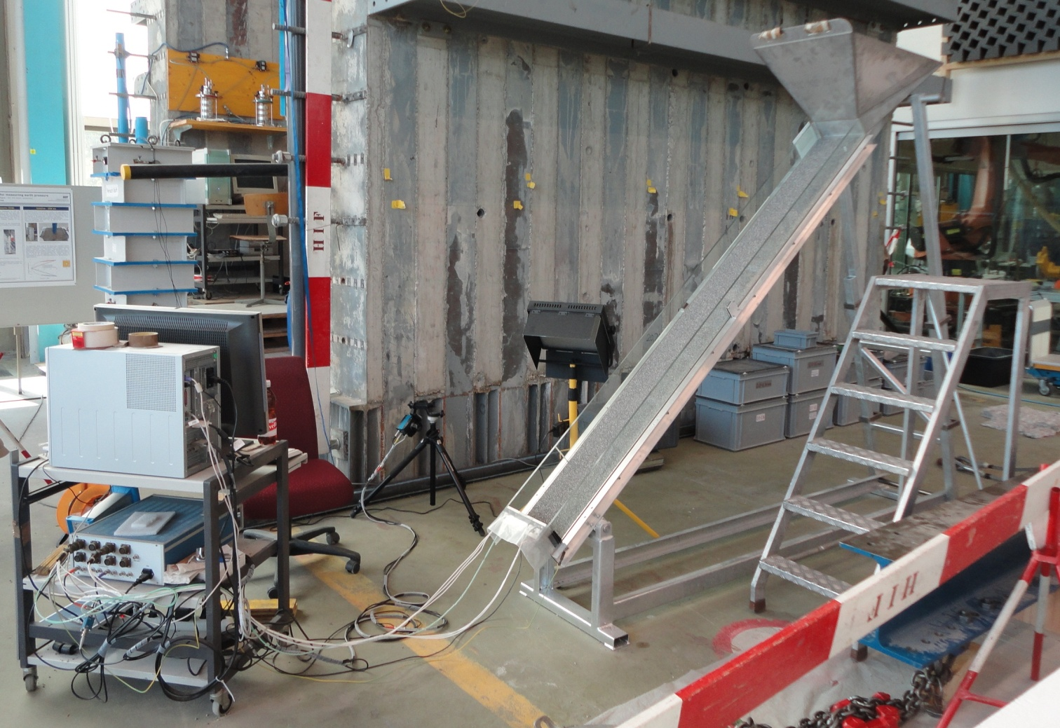
So you have an experiment

Slide 3
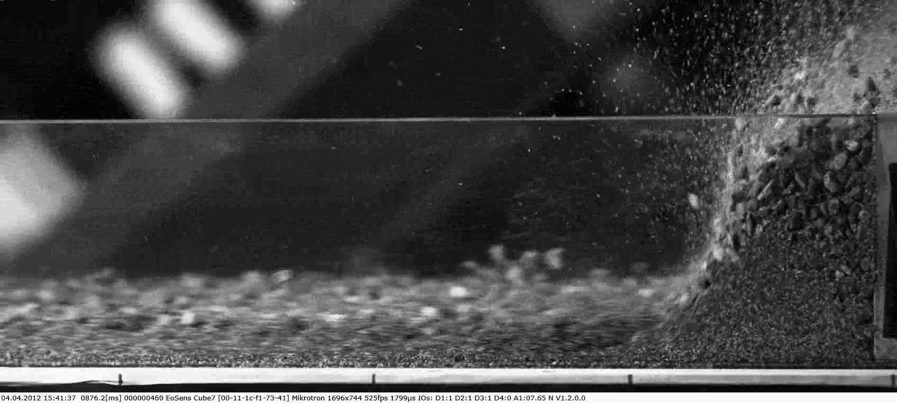
And you see something

Slide 4
Now what?
Observation
Paper
?

Slide 5
Step 1: Set the scene
Black/white backdrop
If you’ll be there a while, get rid of natural light
Vibrations
Data storage
Tripod + quick release + levels

Slide 6
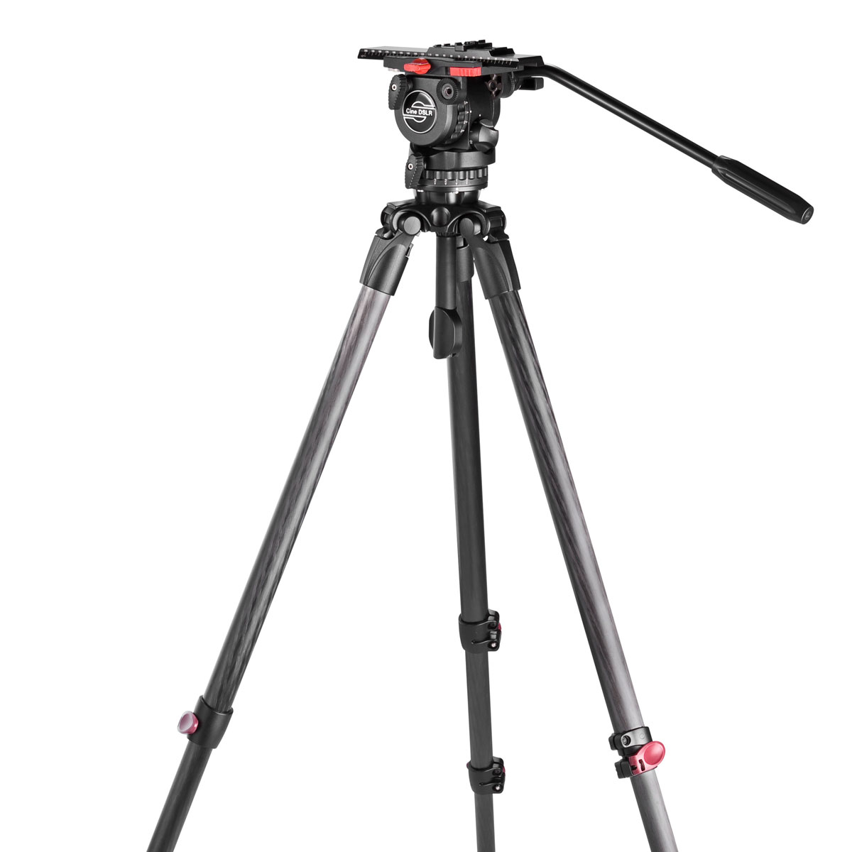
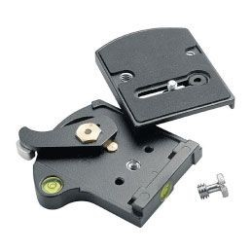
Tripods
(7dslr.com)

Slide 7
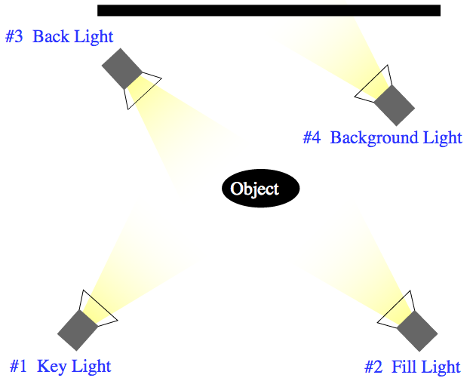
Step 2: Lighting
(wikimedia.org)

Slide 8
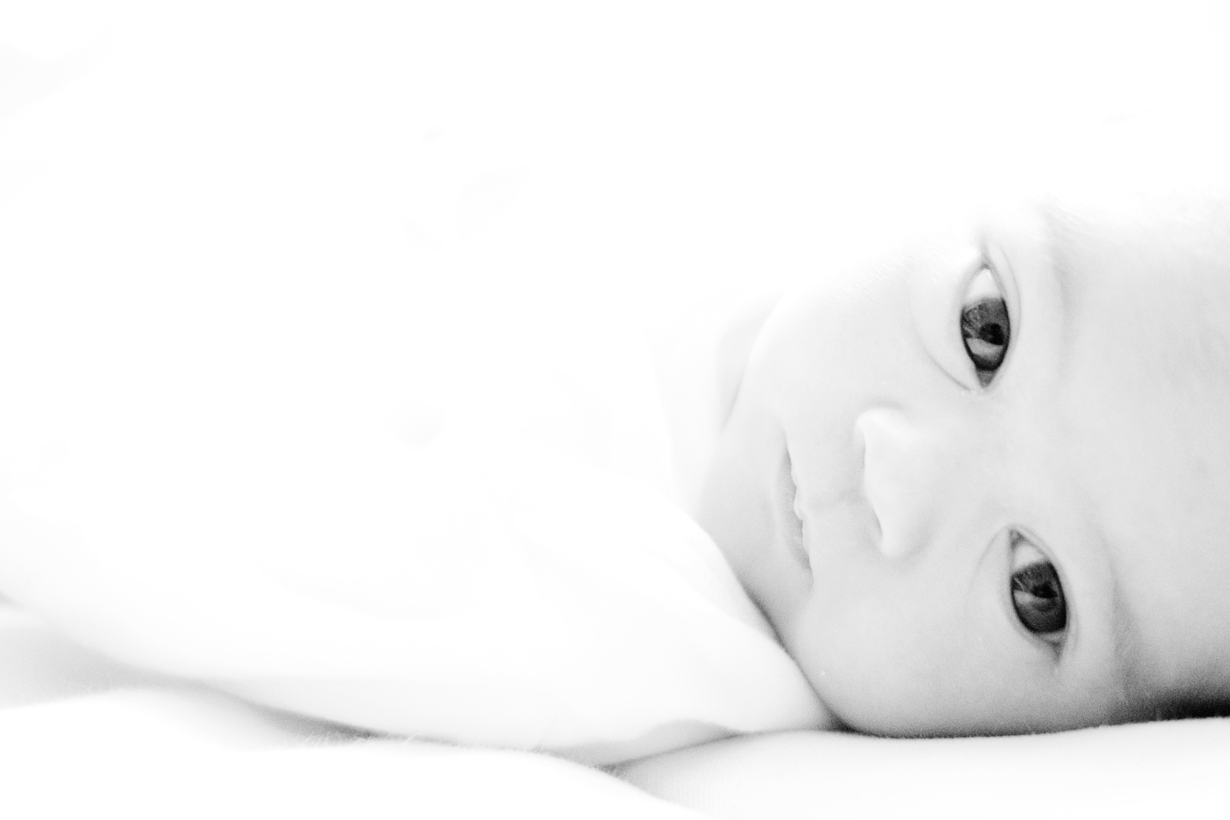
High key lighting
(wikimedia.org)

Slide 9
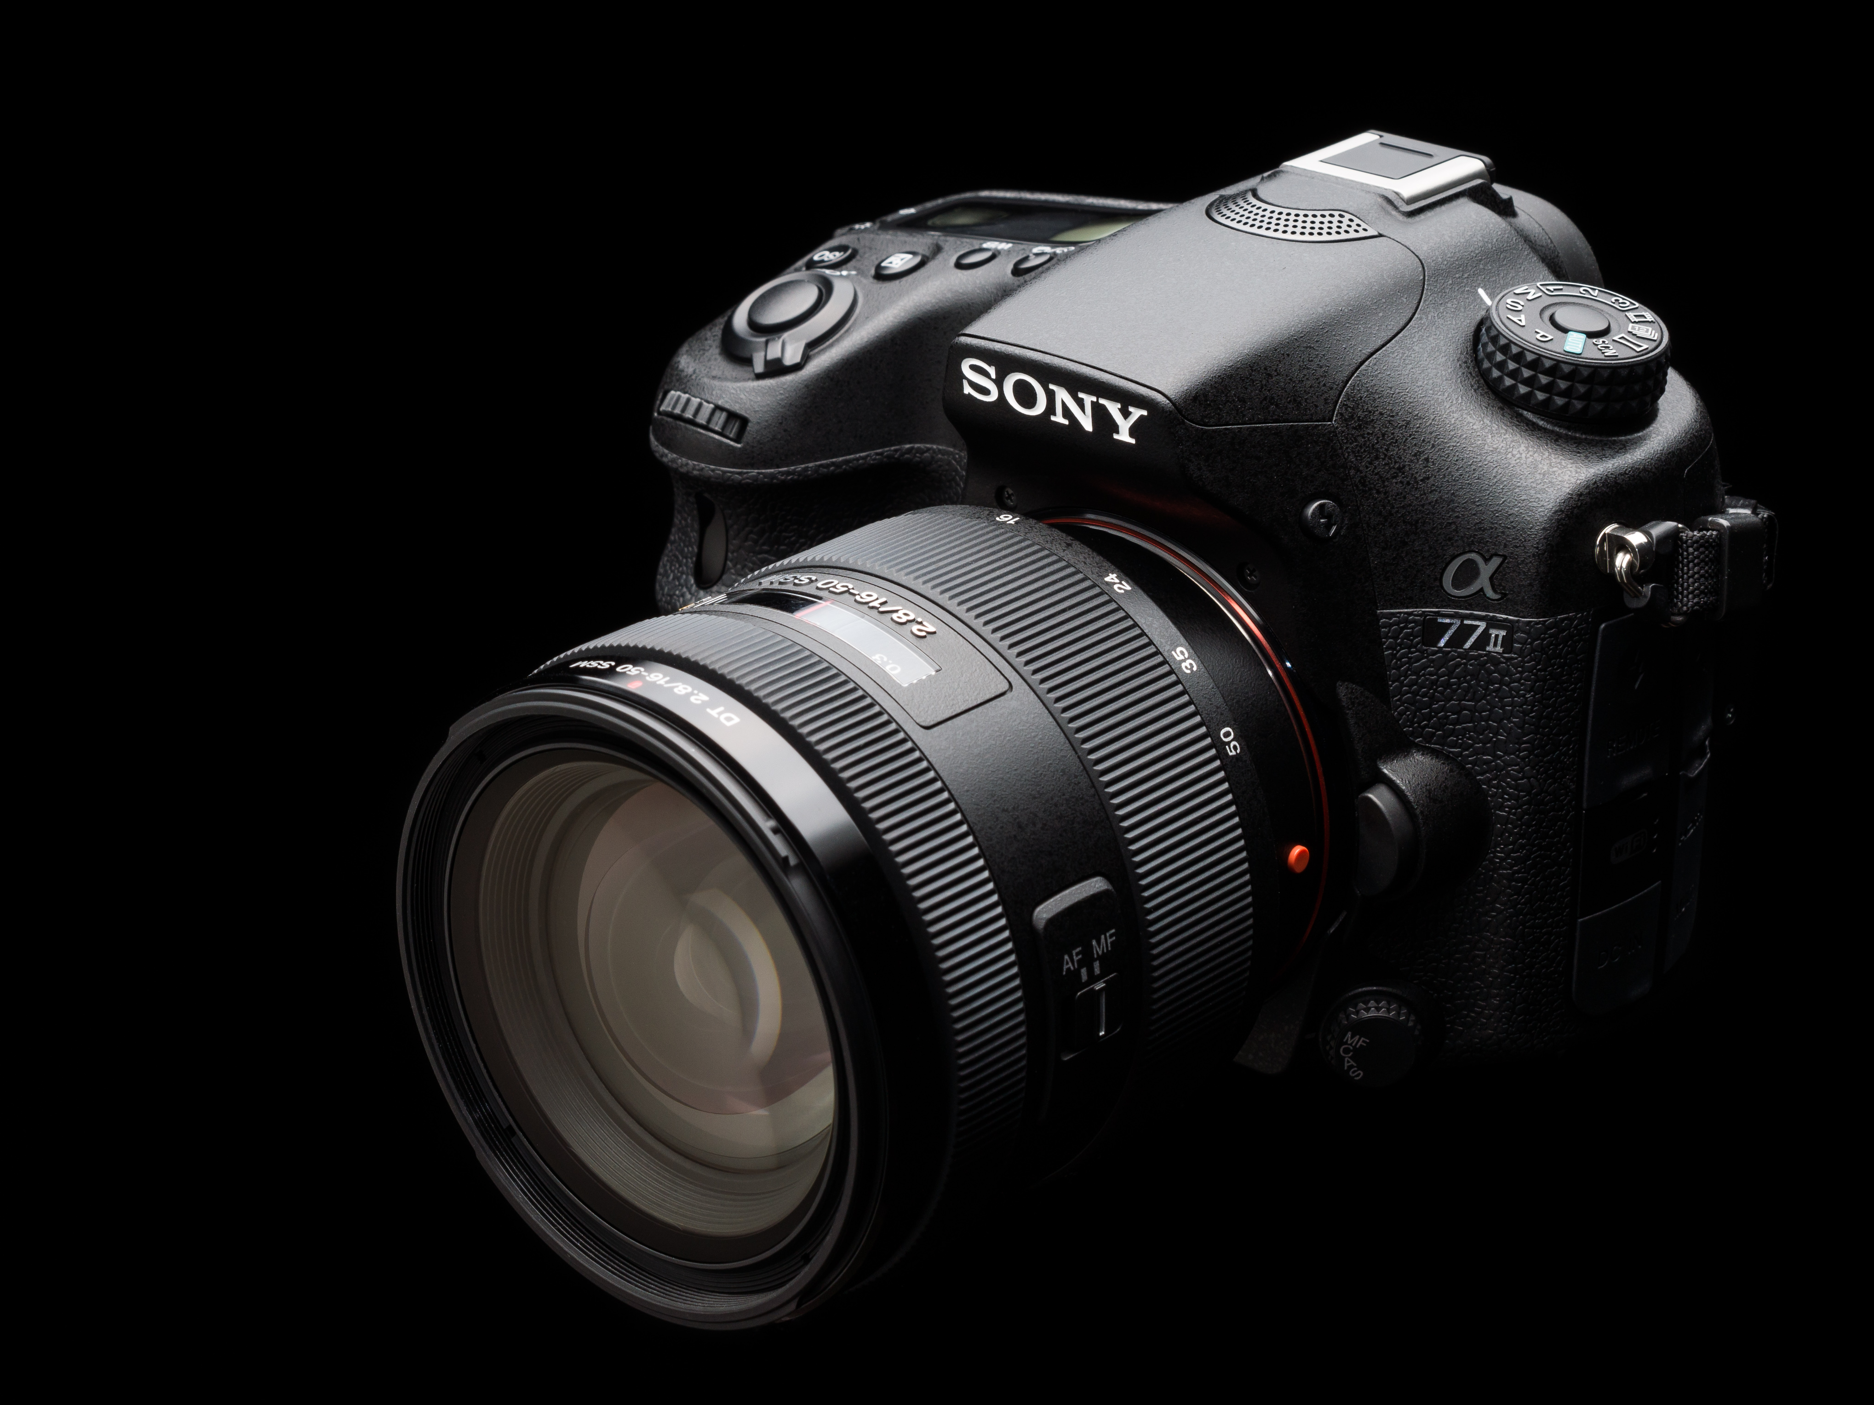
Low key lighting
(wikimedia.org)

Slide 10
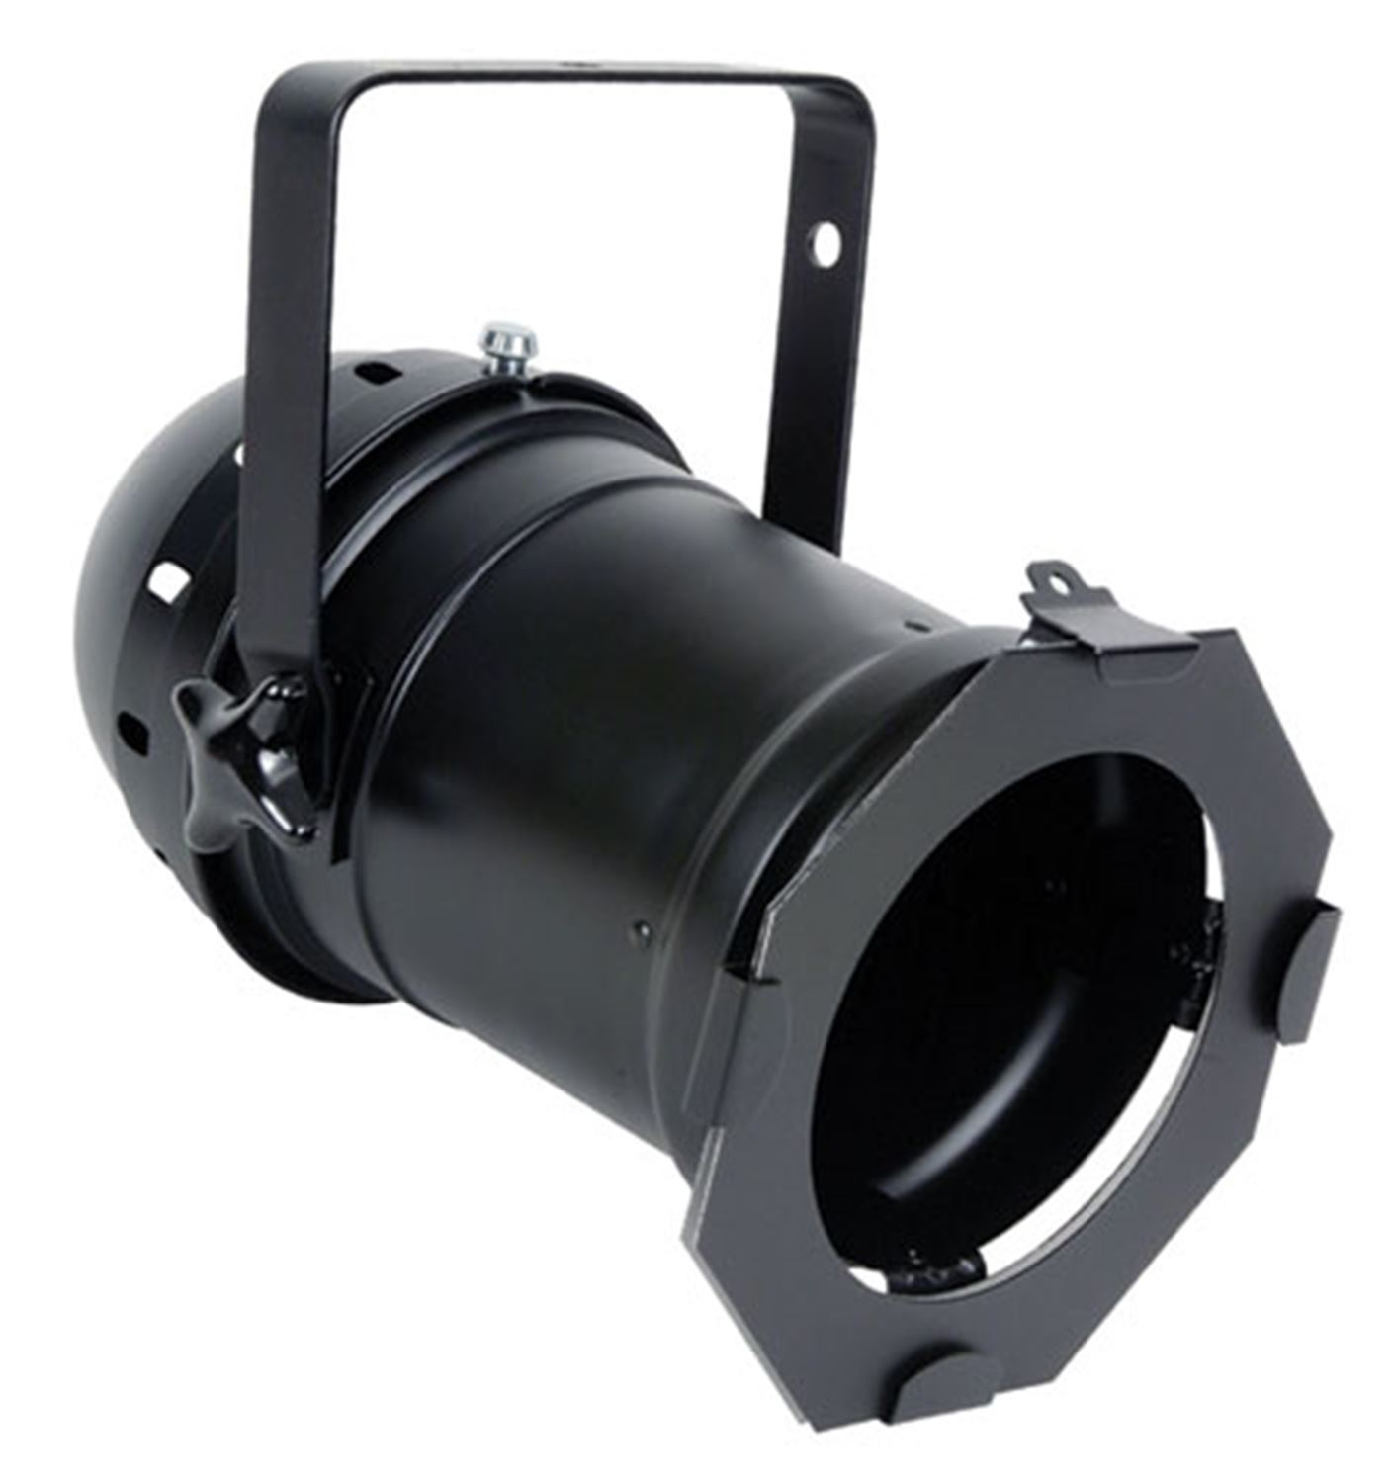
Point sources
(pssl.com)

Slide 11
Point lighting
Camera
Object

Slide 12
Point lighting
Camera
Object

Slide 13
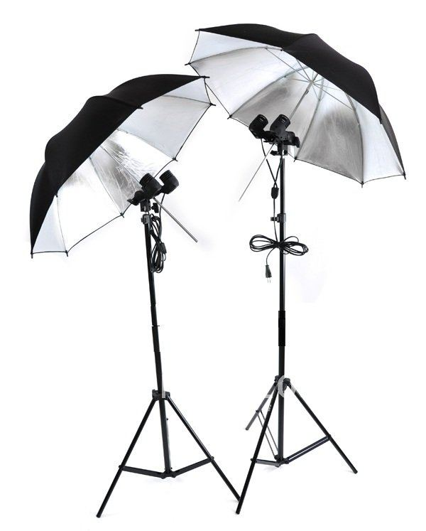
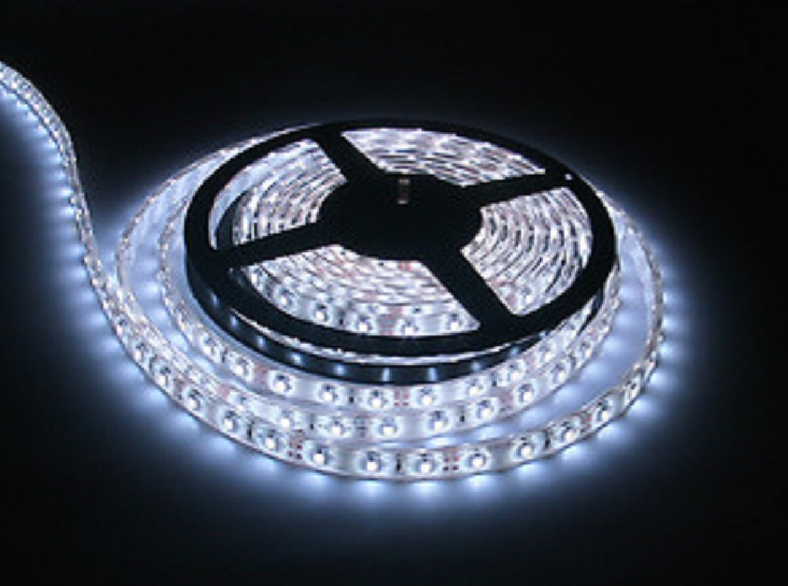
Diffuse lighting
(hsreflections.com.au)
(aliexpress.com)

Slide 14

Light boxes
(kmart.com.au)

Slide 15
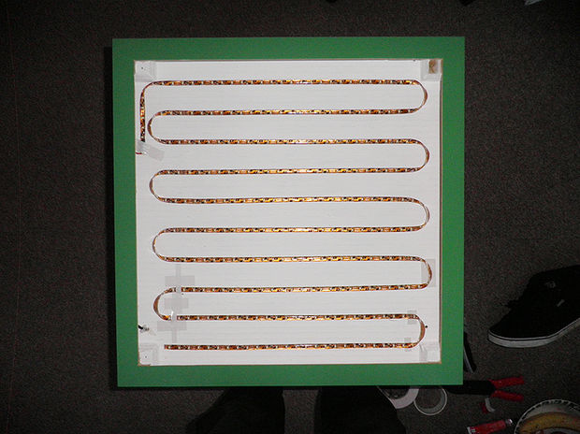
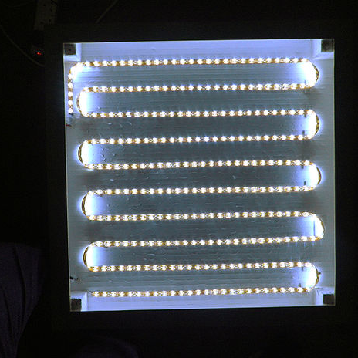
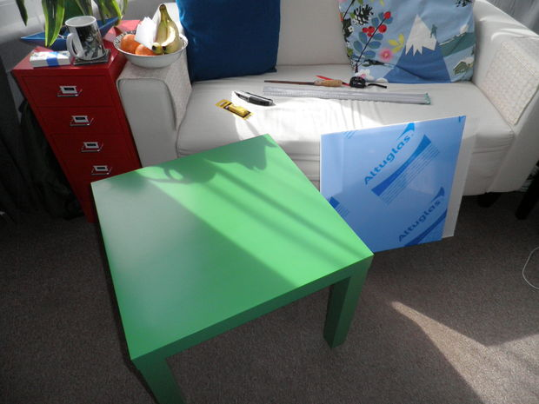
Light boxes
(instructables.com)

Slide 16
Diffuse lighting
Camera
Light box
Light box
Object

Slide 17
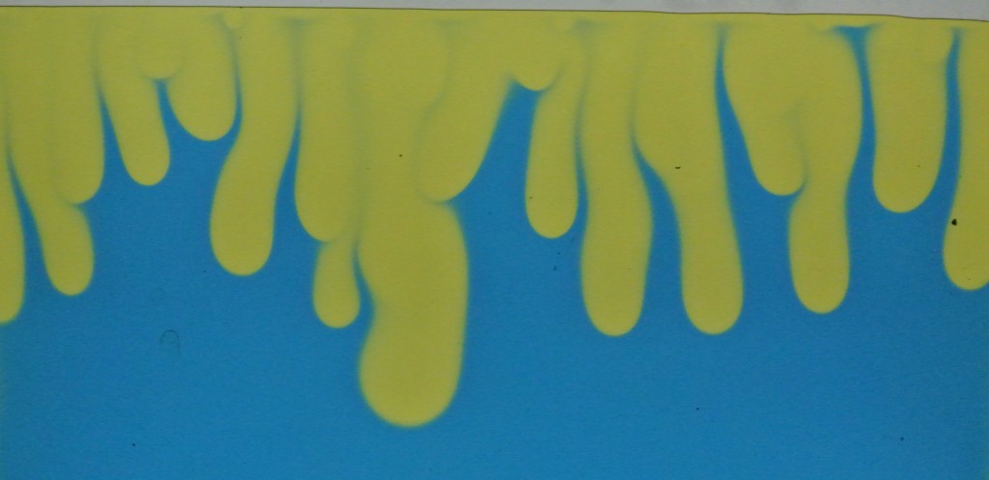
Transmission lighting
Light box
Camera

Slide 18
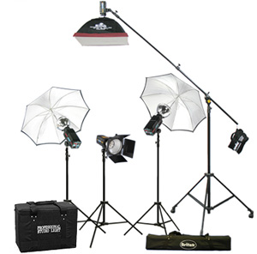
Flashes

Slide 19
Flickering
Normal AC power - 50Hz or 100Hz
Fluorescent lights – 5kHz to 40kHz
DC power – minimal flicker

Slide 20
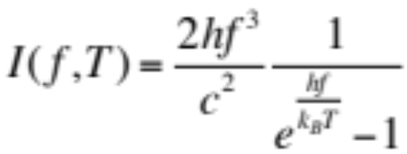
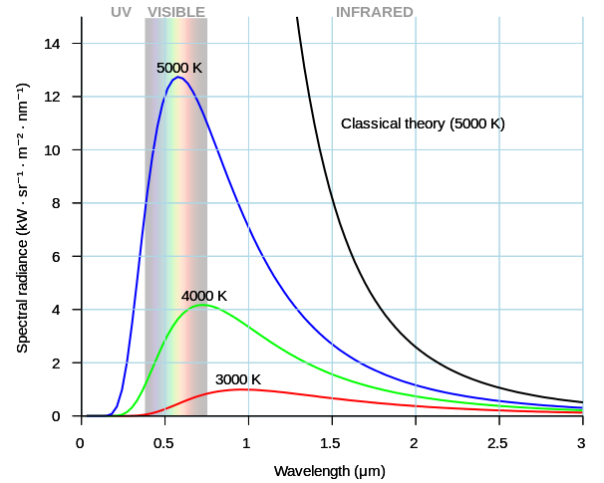
Colour Temperature
Planck’s law:
(wikimedia.org)

Slide 21
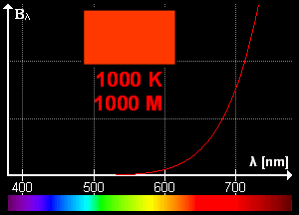
Colour Temperature
Planck’s law:
(wikimedia.org)

Slide 22
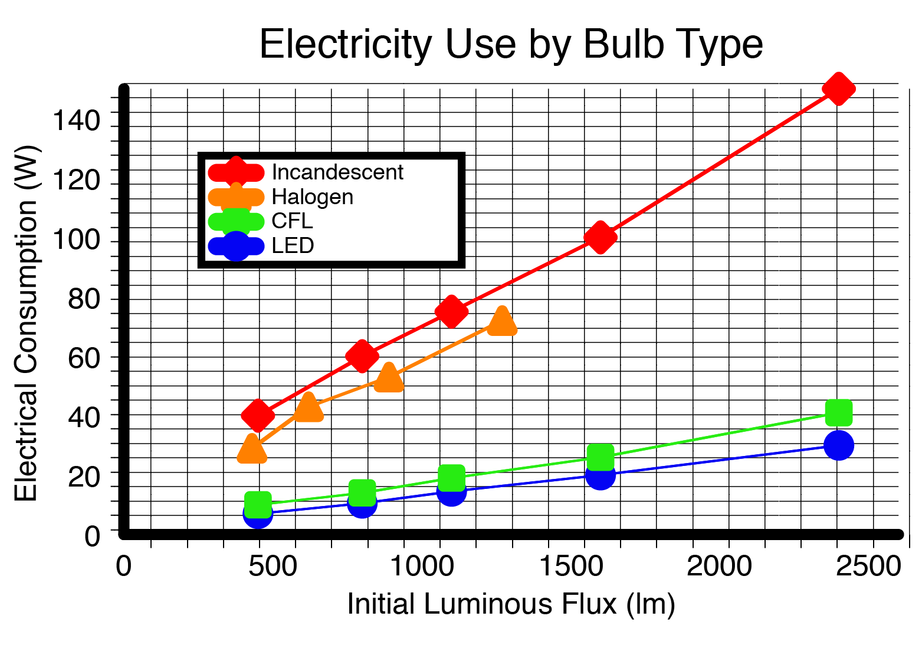
Temperature
(wikimedia.org)

Slide 23
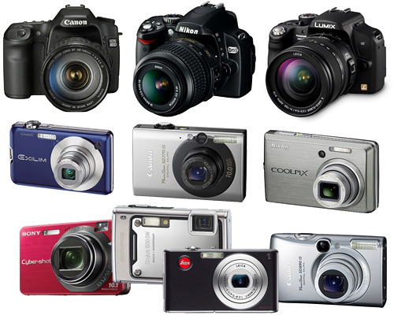
Step 3: Picking a camera
(digital-photography-products.com)

Slide 24
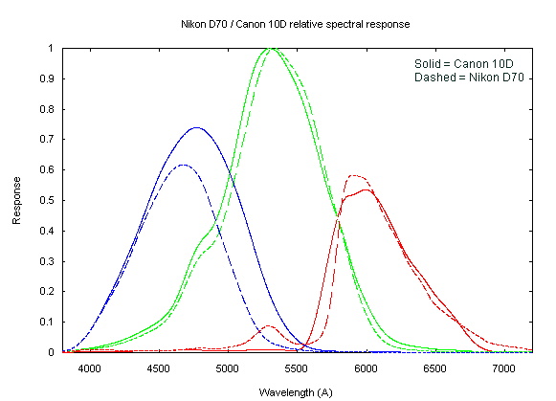
Wavelength
(astrosurf.com)

Slide 25
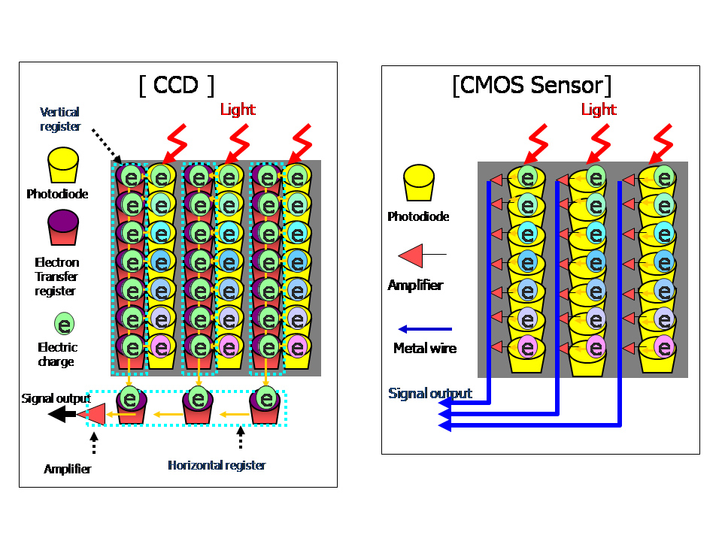
Sensors
(digitalbolex.com)

Slide 26
Sensors
CCD
CMOS
Converts light to electrons
Global shutter
Charge read on all pixels simultaneously
High quality, low noise
Most photons hit sensor
Use lots of power
Expensive to produce
Converts light to electrons
Rolling shutter
Charge read pixel by pixel
More susceptible to noise
Many photons miss sensor
Low power consumption
Cheap to produce

Slide 27
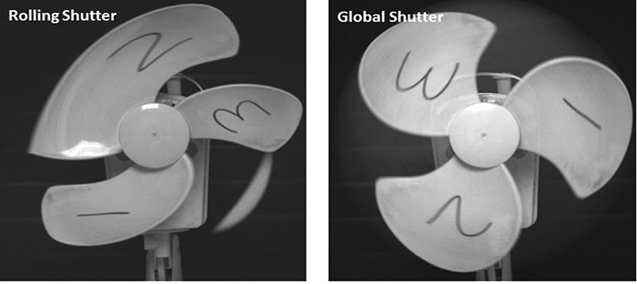
Rolling or global shutters
(andor.com)

Slide 28
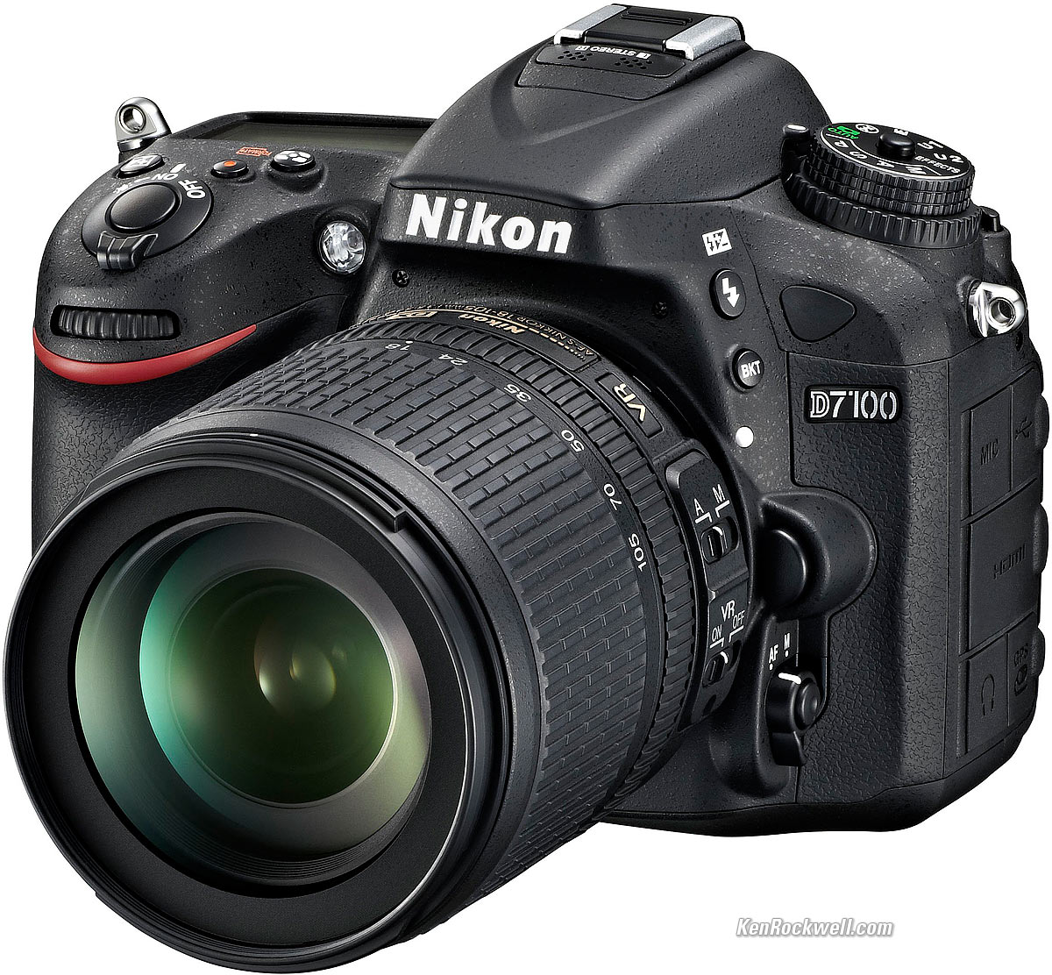
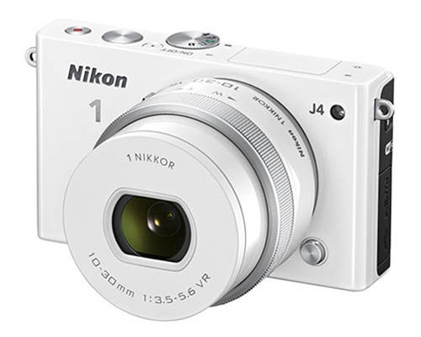
Optical cameras
(kenrockwell.com)
(nikonusa.com)

Slide 29
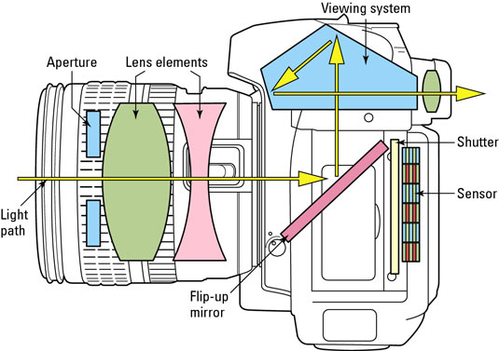
The DSLR
(digit.in)

Slide 30
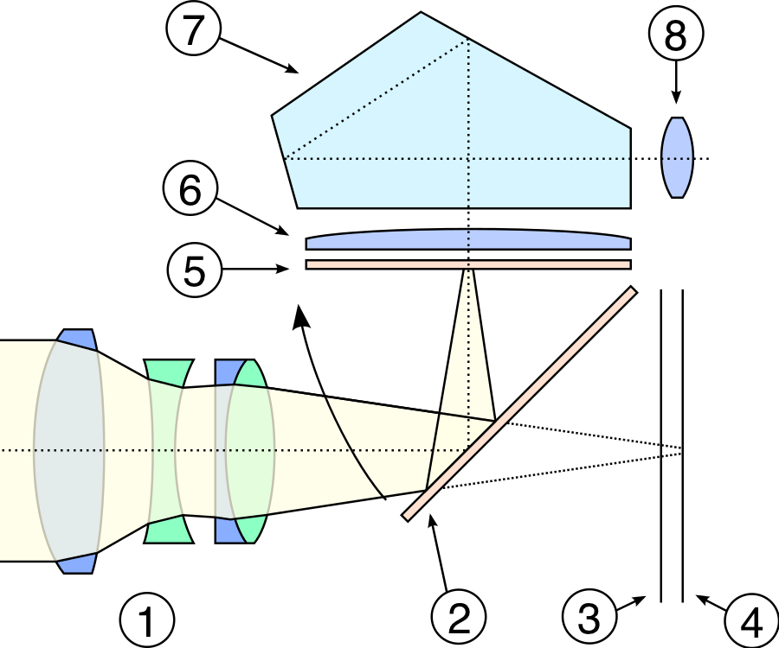
Single lens reflex cameras
Front-mount lens
Reflex mirror
Focal plane shutter
Film or sensor
Focusing screen
Condenser lens
Optical glass pentaprism
Eyepice
(wikimedia.org)

Slide 31
Setting 1: ISO
International Organisation for Standardisation
  IOS in english
  OIN in french
Thought to refer to the greek ‘isos’ (equal)
Proof of the futility of committees

Slide 32
ISO
Refers to light sensitivity
Not one but five independent ways to measure ISO. All subjective.
Can be set manually or automatically
Higher ISO means more sensitive to light
Generally this means less light must be accumulated, and the image becomes ‘grainier’.

Slide 33
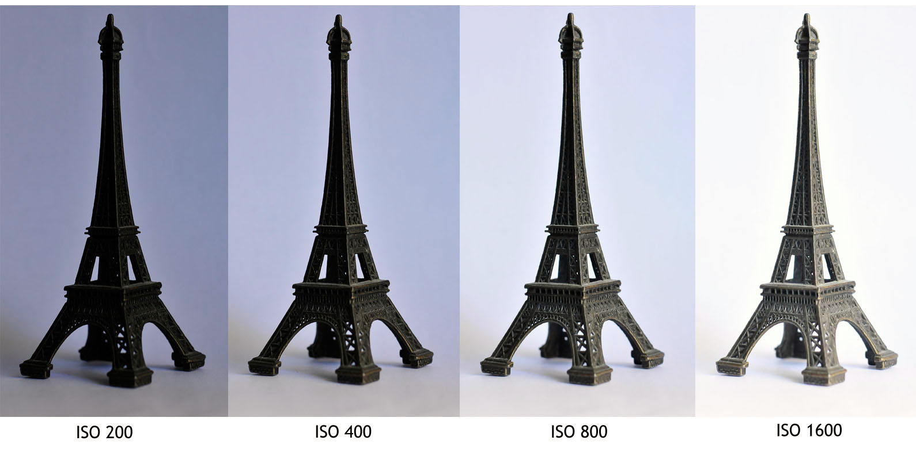
ISO
(International Organisation for Standardisation)
(elliezenhari.com)

Slide 34
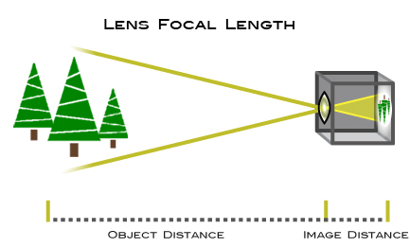
Setting 2: Focal length
(nikonusa.com)

Slide 35
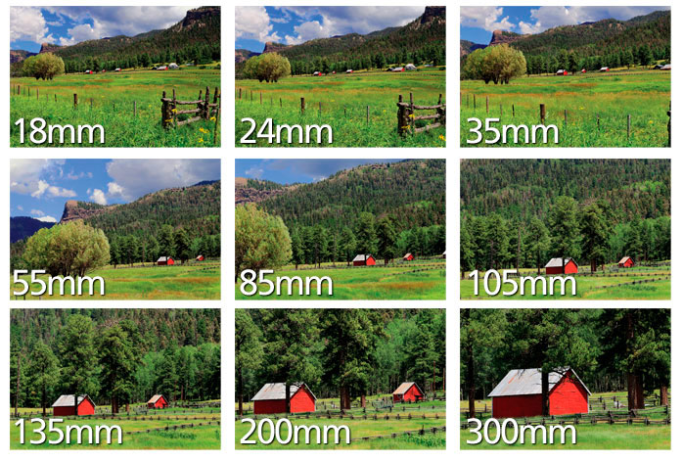
Focal length
(nikonusa.com)

Slide 36
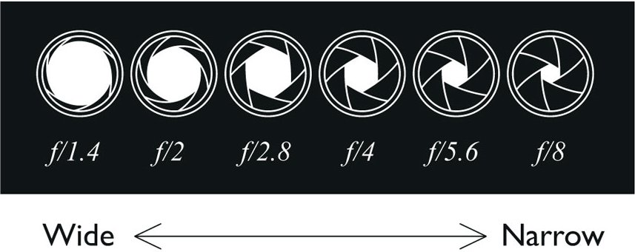
Setting 3: F-stop
(vagabond3.com)

Slide 37
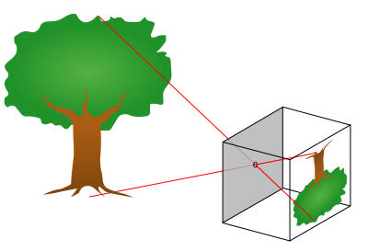
The pinhole effect
(wikimedia.org)

Slide 38
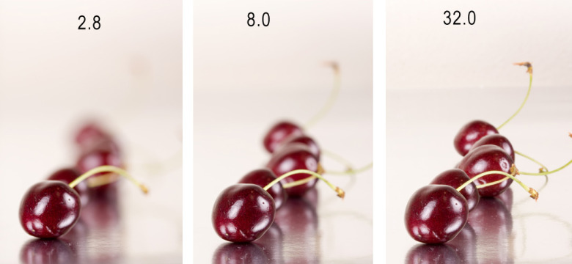
F-stop and depth of field
(simoneskitchen.net)

Slide 39
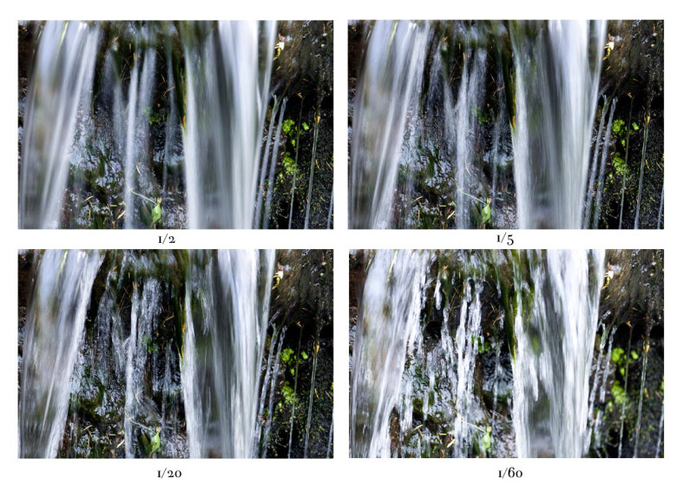
Setting 4: Shutter speed
(sharinakagawaphotography.wordpress.com)

Slide 40
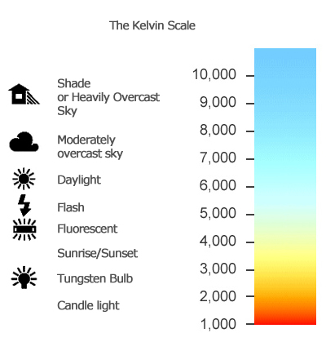
Setting 5: White balance
(learntouseacamera.com)

Slide 41
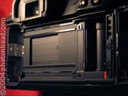
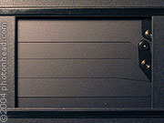
Setting 6: Frame rate
(photohead.com)

Slide 42
Typical frame rates
Still photos
DSLRs: up to 7 fps
MILCs: up to 20 fps
Video
DSLRs: up to 60 fps
MILCs: up to 1200 fps

Slide 43
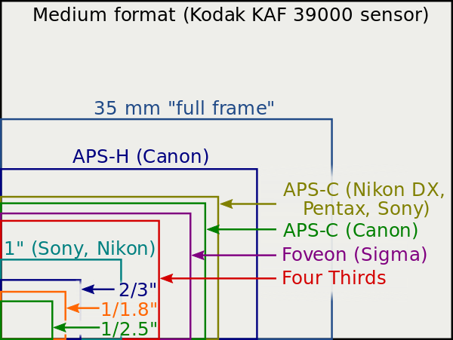
Sensor size
(wikimedia.org)

Slide 44
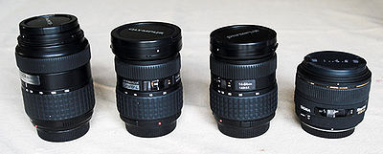
Step 4: Picking a lens
(wikimedia.org)

Slide 45
Picking a lens: Mounts
Canon
  DSLRs take EF mounts
  Mirrorless take EF-M (usually)
Nikon
  DSLRs take F-mount
  Mirrorless take NIKKOR VR
AF/MF

Slide 46
Picking a lens: Focal length
Prime lens – no zoom!
Macro lens
Fish eye
Wide angle
Standard
Portrait
Telephoto
Super Telephoto

Slide 47
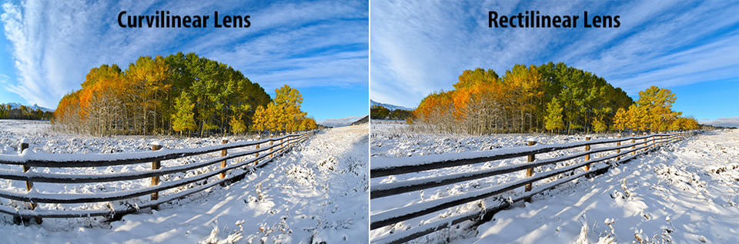
Picking a lens: distortion
(photographylife.com)

Slide 48
Picking a lens: the complexity
Sensor size |  | 35 mm or full-frame | APS-H | APS-C | Four Thirds
Crop factor |  | 1.0 | 1.3 | 1.5 or 1.6 | 2.0
Lens view | Angle diag (deg) | Focal length (mm)
Ultra wide-angle | 118 | 13 | 10 | 8 | 7
Typical wide-angle | 84 | 24 | 18 | 15 | 12
 | 75 | 28 | 22 | 18 | 14
Slightly wide-angle | 63 | 35 | 27 | 23 | 18
“Normal” | 59-47 | 40-50 | 30-38 | 25-32 | 20-25
Portrait lens | 29 | 85 | 65 | 55 | 43
 | 23 | 105 | 81 | 68 | 53
Telephoto | 18 | 145 | 104 | 87 | 68
Long telephoto | 8 | 300 | 231 | 192 | 150
Very long telephoto | 2 | 1200 | 923 | 774 | 600

Slide 49
Shutter release
Push the button
Wired connector
Wireless connector
Smartphone
Tethered to a computer
Simultaneous images?
Using a flash?

Slide 50
Putting it all together
Find the right lens
Choose a low ISO
Small focal range = low f-stop
Appropriate shutter speed
Keep adding lights
Take an image or a time lapse

Slide 51
Image formats
RAW
Tiff
Jpeg
Png

Slide 52
RAW
Essentially a list of pixel voltages
Needs more information
Huge files

Slide 53
Tiff
Tagged image file format
(Can have) lossless image compression
Big files
Good to use

Slide 54
Jpeg
Joint Photographic Expert Group
Flexible lossy compression options
Small files
OK to use

Slide 55
Png
Portable Network Graphics
(Can have) lossless image compression
Supports 8-bit transparency
Only RGB
Not for us

Slide 56
Video formats
RAW video
Mjpeg
Mp4
Avi
MOV
Generally the camera will only give you one option, so use that!

Slide 57
RAW video
Direct sensor output
Needs calibration curves
Massive files
Great for post-processing, but not for us

Slide 58
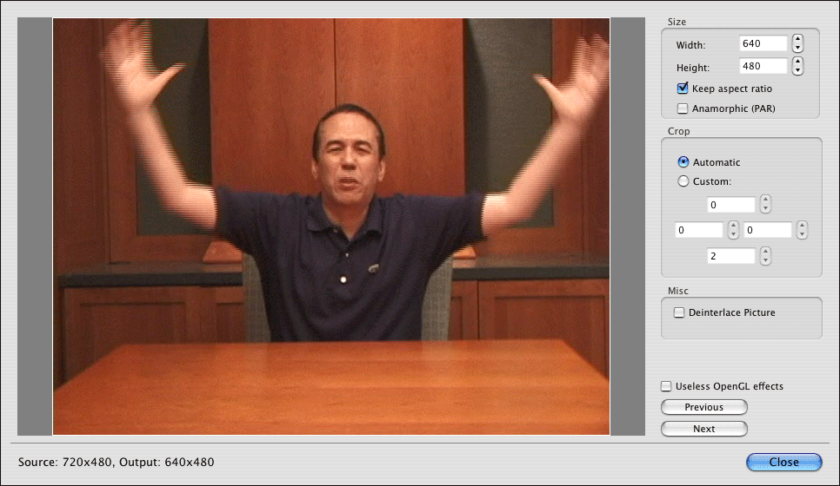
Interlaced and progressive

Slide 59
SD Cards
Space:
  SD: 128MB to 2GB
  SDHC: 4GB to 32GB
  SDXC: 64GB to 2TB
Speed:
  Class 2: 2 MB/s
  …
  Class 10: 10MB/s
  UHS-I: 50-100 MB/s
  UHS-II: 150-300 MB/s

Slide 60
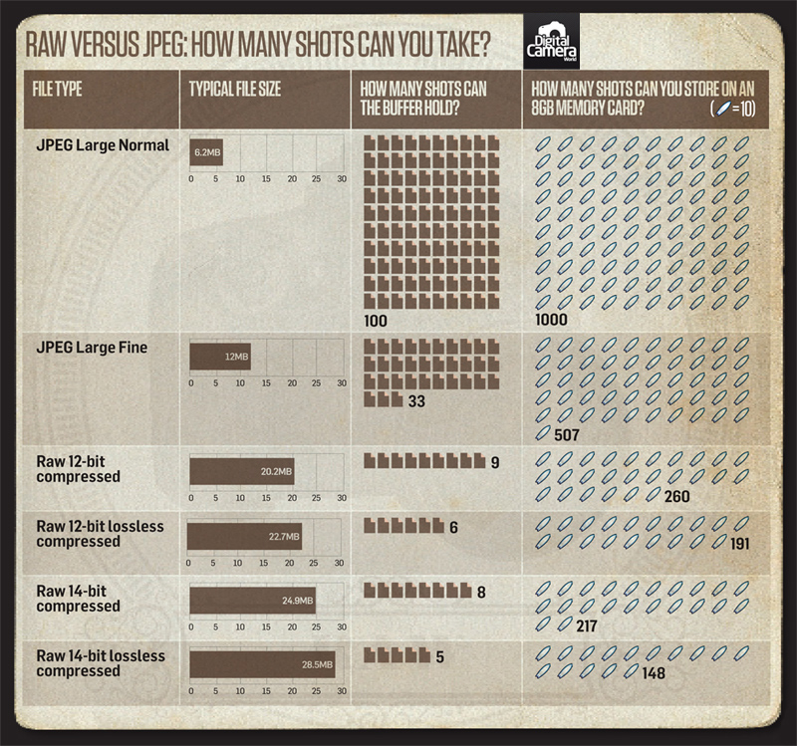
Storage
(digitalcameraworld.com)

Slide 61
Tethering
Windows: Camera Control Pro (paid)
Mac: Remote Camera Control (free)
Linux: gphoto2 (open source)
+ many, many others….
Live view on Mac/Windows only! (at least for Nikon)

Slide 62
Common conversions
Command line tools:
  Any OS: ffmpeg
  Mac OSX: image magick
Graphical tools:
  Any OS: ImageJ (Fiji)
  Any OS: GIMP
  Complicated: Photoshop

Slide 63
Between image types
Convert NEF to JPG:
ufraw-batch *.nef --out-type=jpeg
Rotate an image:
convert *.jpg -rotate 180 1%04d.jpg

Slide 64
Image to video
Convert JPG to mp4:
avconv -f image2 -i *.jpg -r 20 foo.mp4

Slide 65
Video to image
Convert movie to jpg:
avconv -i foo.mov -vsync 1 -r 25 -an -y -qscale 1 out_%04d.jpg
OR
ffmpeg -i video.mpg image%d.jpg

Slide 66
Loading up images
Matlab:
  imread(filename);
Python:
  np.imread(filename)
  cv2.imread(filename)
  PIL.Image.open(filename)
ImageJ (Fiji):
  File -> Open

